Slide 1
Functional programming With Vavr and Resilience4j

Slide 2
WHAT does functionals programming out?
Functions are "first-class citizen”
Functions can be assigned to variables
Composition of functions
Higher order functions
Functions can be passed as parameters
Functions can be returned as a result
Functions without side effects (referential transparency)
Persistent (immutable) data structures
Algebraic data types (sum and product types)

Slide 3
Composition of FUNCTIONS
Functions can be chained together
Applying a function to the result of another function creates a new function.
The functions f: X → Y and g: Y → Z can be concatenated to form a function h: g (f (x)) with h: X → Z.
Input value
function
Result
X
Y
Z
f (x)
g (x)
andThen()
X
Z
g (f (x))

Slide 4
Composition of FUNCTIONS
Function1 <Integer, Integer> plusOne = a -> a + 1; Function1 <Integer, Integer> multiplyByTwo = a -> a * 2; Function1 <Integer, Integer> plusOneAndMultiplyBy2 = plusOne.andThen(multiplyByTwo); then(plusOneAndMultiplyBy2.apply (2))
.isEqualTo(6th);

Slide 5
What are HIGHER ORDER FUNCTIONS?
Functions can be passed as parameters
Functions can be returned as a result
Separation of responsibilities (separation of Concerns)
Patterns: Execute-Around, Deferred Execution, Decorator, Strategy, Template Method
Functions
Higher order function
Business logic
Business logic with error handling and Fallback
Error handling
withRecovery()
Fallback

Slide 6
What are HIGHER ORDER FUNCTIONS?
private <T, R.> Function1 <T, R.> withRecovery( CheckedFunction1 <T, R.> function, Consumer <Throwable> exceptionHandler, Function1 <T, R.> recoveryFunction) { return (T t) -> { try { return function.apply(t); } catch (Throwable ex) { exceptionHandler.accept(ex); return recoveryFunction.apply(t); } }; }

Slide 7
What are HIGHER ORDER FUNCTIONS?
Function1 <String, String> funcWithRecovery = withRecovery( (input) -> service.sayHelloWorld(input), ex -> logException(ex), (input) -> "Hello to " + input);
String result = funcWithRecovery.apply("JUG Darmstadt")

Slide 8
What are HIGHER ORDER FUNCTIONS?
VAVR has the Recovery-Function with built-in
CheckedFunction1 <String, String> function =
(String input) -> service.sayHelloWorld(input); Function1 <String, String> funcWithRecovery = function.recover(ex -> { logException(ex); return (input) -> "Hello to " + input; });
String result = funcWithRecovery.apply("JUG Darmstadt");

Slide 9
WHAT is Referential Transparency?
The call a function with the same parameters always delivers the same result and is therefore independent of the context
Functions without Side effects
are lighter to testing
can With other Functions combined become
Class a
Instance variable
Throws an error message
Modified/read
X
Y
Z
Function a
Function B
Control flow

Slide 10

(PURE) Functions with no side effects
Potential input:
parameter
Instance variables
global variables
Potential output:
Return value
Instance variables
Global variables
Exception
Variable parameters
Potential input:
Immutable parameters
Potential output:
Immutable return value

Slide 11
FUNCTIONAL error handling
A value can be wrapped in a context
If one applies a function to the packed value, it can depending on the context have a different result
value and Context (Monad)
7th
-2
5
Input values
+3
8, 2
5
divide
4th
map
7th
flatMap
Try (Either)
4th
Failure (Left)
Sucess (Right)

Slide 12
FUNCTIONAL error handling
8, 2
divide
4th
map
7th
recover
7th
+3
8th
Success
8, 0
map
recover
8th
divide
public Try <Integer> divide(int dividend, int divisor) { return Try.of(() -> dividend / divisor) .map(quotient -> quotient + 3) .recoverWith(ex -> Try.success(dividend)); }
int result = divide(8th,2).get();

Slide 13
Function with side effects
Function has no return value
A Instance variable will be modified
The error message is part of the control flow, but not part of the signature
List <User> users = new ArrayList<> (); public void addUser(User user) {
// Throws one Exceptionif the user is a hacker.
if(user.getName().equals("Hack0r")) { throw new InvalidNameException(); }
// change one Instance variable users.add(user); }

Slide 14
FUNCTION WITHOUT SIDE EFFECT
Possible validation errors are made explicit in the signature
Either<ValidationError, List <User>> addUser(List <User> users, User user) { Validation <ValidationError, User> validation = validate(user); return validation .map(users::prepend) .toEither(); } Validation <ValidationError, User> validate(User user) { if(user.getName().equals("Hack0r")) { return Validation.invalid(new InvalidNameError()); } return Validation.valid(user); }

Slide 15
imperative vs. functional: Separation of CONCERNS
List <String> errors = new ArrayList<> (); int errorCount = 0; FileReader fr = new FileReader(fileName); BufferedReader br = new BufferedReader(fr); String line = br.readLine(); while (errorCount <40 && line ! = zero) { if(line.startsWith("ERROR")){ errors.add(line); errorCount++; } line = br.readLine(); }
List <String> errors = Files.lines(Paths.get(fileName)) .filter(l -> l.startsWith("ERROR")) .limit(40)
.collect(toList());

Slide 16
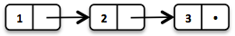
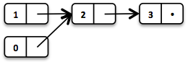
What are persistent data structures?
Returns when there is a change returns a modified copy of itself and retains its previous state
No side effects possible
Data structures can share values ​​held in memory
Storage efficiency
List <Integer> list1 = Cunning.of(1, 2, 3); List <Integer> list2 = list1.replace (1,0);

Slide 17
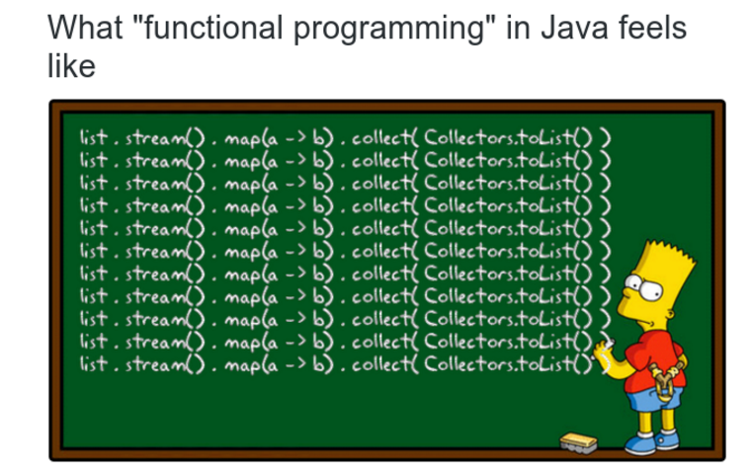
Functional PROGRAMMING with JAVA 8
Java Collections API full of side effects
add(), remove(), clear()
Only three new data structures (optional, stream, CompletableFuture)
Only functional interfaces with up to two parameters (Function, BiFunction, ...)
Cumbersome Collection API: list.stream().map(...).collect(toList())

Slide 18



JAVASLANG IS now VAVR

Slide 19
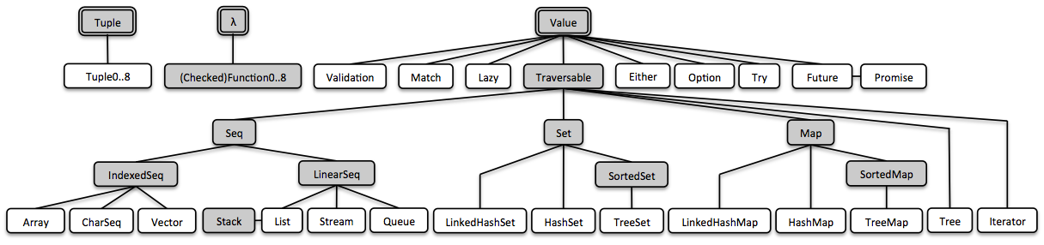
What is VAVR?
A library that provides persistent data structures and algebraic data types for Java8
The naming is based on Scala

Slide 20
VAVR: persistent data structures
The data structures can be converted as required
// stream() and collect(...) are not necessary
List <String> filterOranges(List <String> fruits) { return fruits
.map(String ::toUpperCase) .filter(fruit -> fruit.equals("ORANGE")); }
List <String> fruits = Cunning.of("orange", "apple", "lemon"); java.util.List<String> oranges = filterOranges(fruits).toJavaList();
java.util.List<String> fruits = Arrays
.asList("orange", "apple", "lemon"); List <String> oranges = filterOranges(Cunning.ofAll(fruits));

Slide 21
VAVR: persistent data structures
// Java9 Factory method for initialization
Map<String, MonetaryAmount> prices = HashMap.of( "orange", Money.of(2, "EUR"), "apple", Money.of(1.50, "EUR"), "lemon", Money.of(1, "EUR"));
// Option is built into the API Option <MonetaryAmount> peachPrice = prices.get("peach"); Map<String, MonetaryAmount> doubledPrices = prices
.mapValues(price -> price.multiply(2)); MonetaryAmount price = Cunning.of("orange", "orange", "apple") .map(doubledPrices) .reduce(MonetaryAmount::add);
then(price).isEqualTo(Money.of(11, "EUR"));

Slide 22
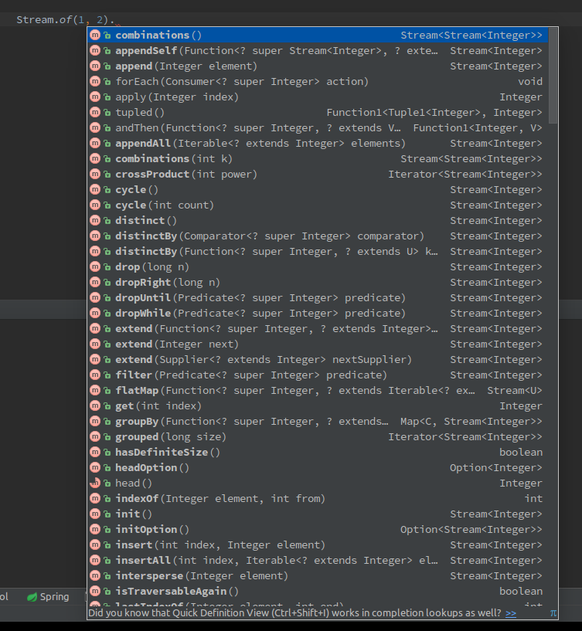

VAVR: persistent data structures
OMG!

Slide 23
VAVR: Algebraic data types
Product types: usually contain several values ​​called fields
Tuple0… 8
Sum or variant types: There is only a fixed number of variants for each type
Try (Sucess, Failure)
Either (Left, Right)
Option (Some, None)

Slide 24
VAVR: TUPLES
There are Tuple with up to 8 fields
Tuples are useful when a function has more than one return value
// = (Java, 8) Tuple2 <String, Integer> java8 = Tuple.of("Java", 8th);
// = (vavr, 1) Tuple2 <String, Integer> vavr1 = java8.map ( s -> s.substring(2) + "vr", i -> i / 8th); String vavr = vavr1._1; int one = vavr1._2;

Slide 25
VAVR: Try
Represents a calculation that is either successfully completed (Success) or ended with an error (Failure)
// Service interface with Checked exception interface HelloWorldService { String sayHelloWorld(String Surname) throws BusinessException; }
String result = Try.of(() -> service.sayHelloWorld("JUG Darmstadt")) .map(value -> value + "and all other JUGs")
.onFailure(throwable -> LOG.warn("Handled exception", throwable))
.recover(BusinessException.class, throwable -> "I have to go!") .getOrElse(() -> "I have to go too")
interface HelloWorldService { Try <String> sayHelloWorld(String Surname); }

Slide 26
VAVR: EITHER
Represents one of two possible types
Suitable as either ... or Return value (Right or Left)
Can also be used as an alternative to Option and Try
Right comparable to Some or Success
Left comparable to None or Failure
Either<Exception, String> either = Either.right("Hello world"); String result = either .map(String ::toUpperCase) .get();
then(result).isEqualTo("HELLO WORLD");
Try <String> toTry = either.toTry(); Option <String> toOption = either.toOption();

Slide 27
VAVR: option
Represents an optional value (Some or None)
Has more operators than Java 8's and is optional serializable
Can be converted to other data types such as Try or Either be converted
String helloWorld = Option.of("Hello") .map(value -> value + " world") .peek(value -> LOG.debug("Value: {}", value)) .getOrElse(() -> "I have to go!");

Slide 28
VAVR: Lazy
Represents a value that may not have been calculated yet
The calculation is thread-safe
Can you do it with a Supplier compare, but has one major difference: The calculated value is cached
Lazy<Double> lazy = Lazy.of(Math::random); lazy.isEvaluated(); // = false lazy.get(); // = 0.123 (random generated) lazy.isEvaluated(); // = true lazy.get(); // = 0.123 (cached)

Slide 29
VAVR: Functions - Currying
Allows partial application of a function by converting a function with N arguments to a modified function with N-1 arguments
A function with two arguments f: A1 x A2 → B is converted into a modified function with one argument f ': A1 → (A2 → B)
One or more parameters are set from left to right
Function2 <Integer, Integer, Integer> sum = (a, b) -> a + b; // Parameter a is set to 2 Function1 <Integer, Integer> add2 = sum.curried().apply(2); then(add2.apply (4th)).isEqualTo(6th);

Slide 30
VAVR: Functions - Memoization
Enables that a method is only executed the first time it is called and the saved value is returned on subsequent calls
Function0 <Double> cachedRandom = Function0.of(Math::random).memoized(); double randomValue1 = cachedRandom.apply(); double randomValue2 = cachedRandom.apply(); then(randomValue1).isEqualTo(randomValue2);

Slide 31
VAVR: Functions - lifting
Allows convert a partial function into a total function that returns the data type option.
A partial function from X to Y is a function f: X '→ Y, where X' is a subset of X
A partial function only works correctly for part of the input values ​​and throws an error if the input is invalid
Function2 <Integer, Integer, Integer> divide = (a, b) -> a / b; Function2 <Integer, Integer, Option <Integer>> safeDivide = Function2.lift(divide); Option <Integer> result1 = safeDivide.apply(4th, 0);
then(result11).isEqualTo(Option.none());
Option <Integer> result2 = safeDivide.apply(4th, 2);
then(result2).isEqualTo(Option.some(2));

Slide 32
VAVR: PATTERN MATCHING
Pattern Matching allows a value to be checked against patterns
Powerful alternative to Java's Switch statement
$ () - wildcard pattern
$ (value) - Equals pattern
$ (predicate) - Conditional pattern
public String patternMatching(Integer i) { return match(i).of( Case($(1), () -> "1"), Case($(isIn(2, 3)), () -> "2 or 3 "), Case($(anyOf(is(4th), noneOf(is(5), is(6th)))),
() -> "4 or neither (5 or 6)"),
Case ($ (instanceOf(Number.class)), "Is a number"), Case($(), () -> "?")); }

Slide 33
VAVR: PATTERN MATCHING
VAVR makes that possible destructuring of objects
User user = new User ("Hack0r", "Id01");
Validation <ValidationError, String> validateUser(User user) { if(user ! = zero && user.getName().equals("Hack0r")) { return Validation.invalid(new InvalidNameError(user.getId())); } return Validation.valid(user.getId); }
Validation <ValidationError, String> result = match(user).of( Case ($ User ($("Hack0r"), $()), (Surname, id) ->
Validation.invalid(new InvalidNameError(id))), Case($(), () -> Validation.valid(user.getId())));

Slide 34
VAVR: PATTERN MATCHING
Annotation processor around Destructor to generate
@Patterns public interface Destructor { @Unapply static Tuple2 <String, String> User(User user) { return Tuple.of(user.getName(), user.getId()); } }

Slide 35

What is Resilience4j?
A lightweight fault tolerance library powered by the Netflix Hystrix was inspired, but is specifically designed for functional programming
Provides higher-order functions with which functional interfaces, lambda expressions and method references can be extended by functionality
CircuitBreaker: Protects functions with a "fuse"
RateLimiter: Limits the Function call rate
Retry: Repeated failed function calls automatically
BulkHead: Limits the number of simultaneous function calls
Cache: Stores function results in a JCache Provider
timer: Measures metrics of function calls
TimeLimiter: Limits the runtime of functions

Slide 36
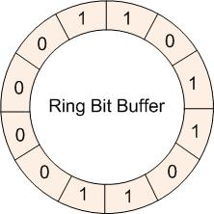
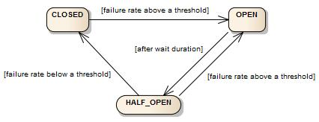
Resilience4j: CIRCUITBREAKER
1000 views
A state machine with three states: CLOSED, OPEN, HALF_OPEN
Configurable threshold value for the error rate
Allows a configurable number of test calls in the HALF_OPEN state
Saves the status of function calls in a two-bit ring Buffer
Array with 16 long (64-bit) values ​​can save the status of 1024 calls
No rolling time window
Error rate 50%
CircuitBreakerOpenException
10 views

Slide 37
Resilience4j: CIRCUITBREAKER
CircuitBreakerConfig circuitBreakerConfig = CircuitBreakerConfig.custom() .failureRateThreshold(50) .waitDurationInOpenState(Duration.ofSeconds(5)) .recordFailure(throwable -> match(throwable).of( Case($(instanceOf(IOException.class)), true), Case($(instanceOf(WebApplicationException.class)), ex -> ex.getResponse().getStatus() == INTERNAL_SERVER_ERROR), Case($(), false))) .build();
CircuitBreaker circuitBreaker = CircuitBreaker.of("backendName", circuitBreakerConfig); Callable<String> decoratedSupplier = CircuitBreaker.decorateCallable(circuitBreaker, () -> service.sayHelloWorld("Robert"));
String result = Try.ofCallable(decoratedSupplier) .getOrElse("I have to go!");

Slide 38
Resilience4j: FUNCTION OF HIGHER ORDER
static <T> Callable<T> decorateCallable(CircuitBreaker circuitBreaker, Callable<T> callable) { return () -> { CircuitBreakerUtils.isCallPermitted(circuitBreaker); try { T returnValue = callable.call(); circuitBreaker.onSuccess(); return returnValue; } catch (Throwable throwable) { circuitBreaker.onError(throwable); throw throwable; } }; }

Slide 39
Resilience4j: CIRCUITBREAKER METRICS
Measures metrics for monitoring
Metrics can be created using Dropwizard Metrics or Prometheus
CircuitBreakerRegistry registry = CircuitBreakerRegistry.ofDefaults(); CircuitBreaker cb1 = registry.circuitBreaker("Name1");
CircuitBreaker cb2 = registry.circuitBreaker("Name2"); CircuitBreaker.Metrics metrics = cb1.getMetrics (); float failureRate = metrics.getFailureRate(); int bufferedCalls = metrics.getNumberOfBufferedCalls(); int failedCalls = metrics.getNumberOfFailedCalls(); int successfulCalls = metrics.getNumberOfSuccessfulCalls(); long notPermittedCalls = metrics.getNumberOfNotPermittedCalls(); MetricRegistry metricRegistry = new MetricRegistry(); metricRegistry .registerAll(CircuitBreakerMetrics.ofCircuitBreakerRegistry(registry));

Slide 40
Resilience4j: CIRCUITBREAKER EVENTS
// event dealer
circuitBreaker.getEventPublisher() .onSuccess(event -> LOG.debug(...)) .onError(event -> LOG.warn(...)) .onStateTransition(event -> LOG.info(…);
// Reactive stream RxJava2Adapter.toFlowable(circuitBreaker.getEventPublisher()) .filter(event -> event.getEventType() == Type.ERROR) .cast(CircuitBreakerOnErrorEvent.class) .subscribe(event -> LOG.warn(...));
// Circular Buffer
CircularEventConsumer<CircuitBreakerEvent> ringBuffer = new CircularEventConsumer<> (10); circuitBreaker.getEventPublisher().onEvent(ringBuffer); List <CircuitBreakerEvent> bufferedEvents = ringBuffer.getBufferedEvents();

Slide 41
Resilience4j: CIRCUITBREAKER RXjava2
There are RxJava2 operators for observables, Flowable and single
CircuitBreaker
RateLimiter
Retry
public Observable <String> methodWhichReturnsAnObservable() { return service.methodWhichReturnsAnObservable() .time-out(1, TimeUnit.SECONDS) .lift(CircuitBreaker operator.of(circuitBreaker)); }

Slide 42
Resilience4j: RETRY
Repeats failed calls and exponentially increases the waiting time between calls
RetryConfig config = RetryConfig.custom() .maxAttempts(3) .waitDuration(Duration.ofMillis(100))
.intervalFunction(IntervalFunction.ofExponentialBackoff()) .retryOnException(throwable -> API.match(throwable).of( Case($(instanceOf(IOException.class)), true), Case($(), false))) .build(); Retry retry = Retry.of("backendName", config); Callable<String> decoratedCallable = CircuitBreaker .decorateCallable(circuitBreaker, () -> service.sayHelloWorld("Robert"));
decoratedCallable = Retry.decorateCallable(retry, decoratedCallable);
String result = Try.ofCallable(decorateCallable) .getOrElse("I have to go!");

Slide 43
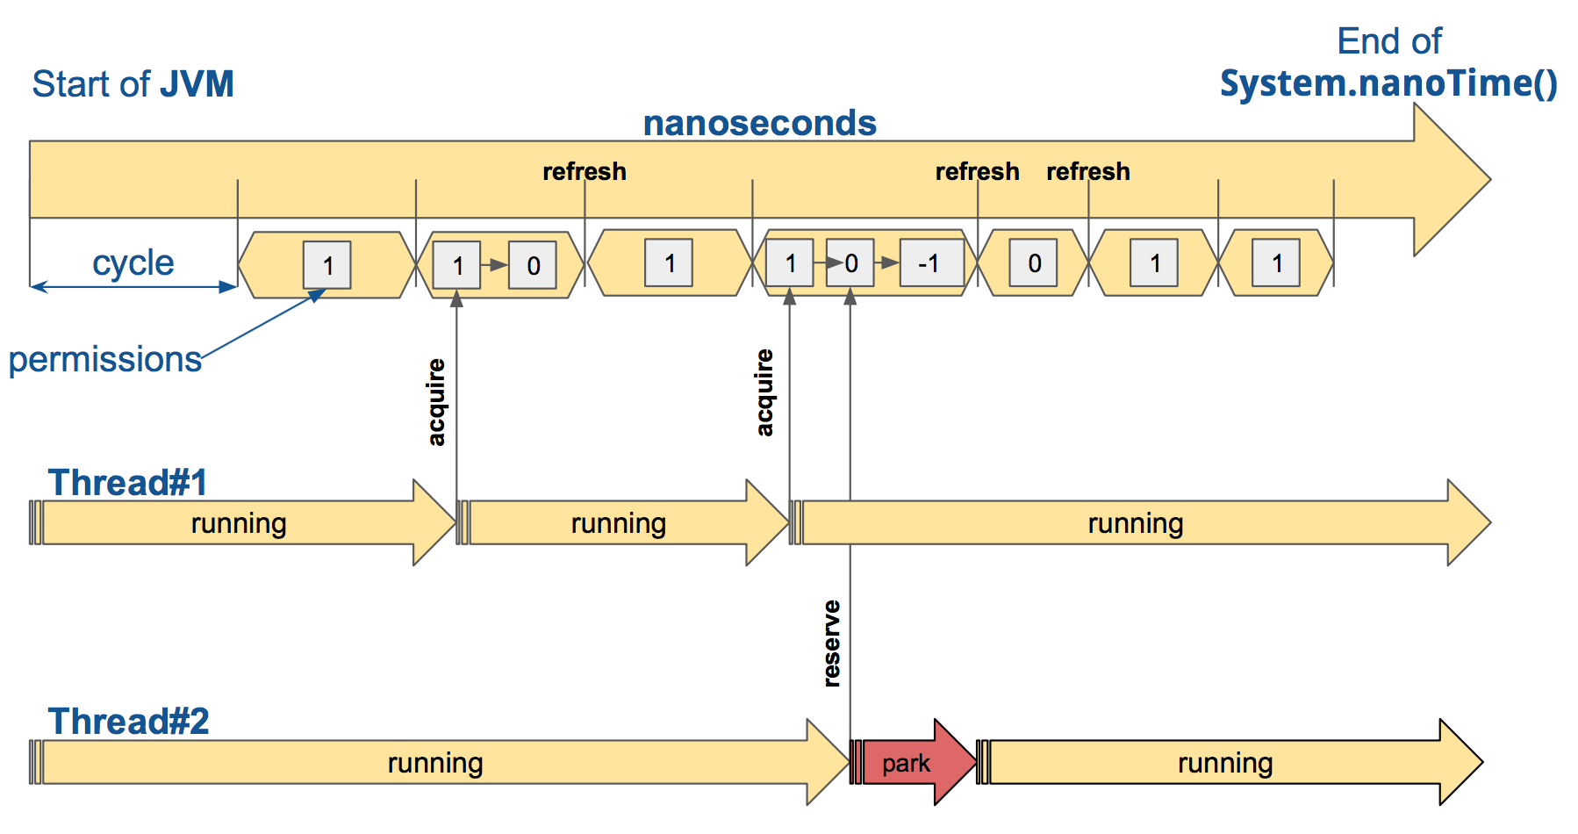
Resilience4j: Rate limiter
Limits the Function call rate
The time is divided into cycles. Each cycle has a configurable duration.
Each cycle allows a configurable number of function calls

Slide 44
Resilience4j: Rate limiter
Allows 1 function call per second
RateLimiterConfig config = RateLimiterConfig.custom() .timeoutDuration(Duration.ofMillis(100)) .limitRefreshPeriod(Duration.ofSeconds(1)) .limitForPeriod(1) .build(); RateLimiter rateLimiter = RateLimiter.of("backendName", config); Callable<String> decorateCallable = RateLimiter .decorateCallable(rateLimiter, () -> service.sayHelloWorld("Robert")); Try <String> firstTry = Try.ofCallable(decorateCallable); then(firstTry.isSuccess()).isTrue();
Try <String> secondTry = Try.ofCallable(decorateCallable); then(secondTry.isFailure()).isTrue(); then(secondTry.getCause()).isInstanceOf(RequestNotPermitted.class);

Slide 45
Resilience4j: BULKHEAD
Limits the number of simultaneous function calls
Allows function calls to either wait or abort with an error
BulkheadConfig config = BulkheadConfig.custom() .maxWaitTime(1000) .maxConcurrentCalls(10) .build(); Bulkhead bulkhead = Bulkhead.of("bar", config); Callable<String> decoratedCallable = Bulkhead .decorateCallable(bulkhead, () -> service.sayHelloWorld("Robert")); Try <String> firstTry = Try.ofCallable(decoratedCallable); Try <String> secondTry = Try.ofCallable(decoratedCallable); then(secondTry.getCause()).isInstanceOf(BulkheadFullException.class);

Slide 46
Resilience4j: TIMER
Integration with Dropwizard Metrics
Measures metrics like
Number of successful and failed calls
Response time and call rate
MetricRegistry metricRegistry = new MetricRegistry(); timer timer = Timer.ofMetricRegistry("baking", metricRegistry);
Callable<String> decorateCallable = timer .decorateCallable(timer, () -> service.sayHelloWorld("Robert")); Timer.Metrics metrics = timer.getMetrics(); long totalCalls = metrics.getNumberOfTotalCalls(); long successfulCalls = metrics.getNumberOfSuccessfulCalls(); long failedCalls = metrics.getNumberOfFailedCalls(); double meanRate = metrics.getMeanRate(); double responseTimePercentile = metrics.getSnapshot() .get95thPercentile ();

Slide 47
Resilience4j: Cache
Uses JCache
Measures metrics like
Number of cache hits
Number of cache misses
javax.cache.Cache<String, String> cacheInstance = Caching.getCache("cacheName", String.class, String.class); Cache <string, String> cacheContext = Cache.of(cacheInstance); Function<String, String> cachedFunction = Cache.decorateCallable(cacheContext,
() -> service.sayHelloWorld("Robert")); String value = cachedFunction.apply("testKey");

Slide 48
Resilience4j: Spring Boot
Spring Boot Starter
Configuration using Spring Boot Config-File
Annotations for CircuitBreaker and RateLimiter
New HealthIndicator For CircuitBreaker and RateLimiter
Events are about a new Actuator Endpoints published
Metrics are handled by the Actuator Metrics released
@CircuitBreaker(backend = "backendA") @Component(value = "backendAConnector") public class BackendAConnector implements Connector { ... }

Slide 49
Resilience4j: Spring Boot - CONFIGURATION
resilience4j.circuitbreaker: backends: backendA: ringBufferSizeInClosedState: 5 ringBufferSizeInHalfOpenState: 3 waitInterval: 5000 failureRateThreshold: 50 eventConsumerBufferSize: 10 backendB: ringBufferSizeInClosedState: 10 ringBufferSizeInHalfOpenState: 5 waitInterval: 5000 failureRateThreshold: 50 eventConsumerBufferSize: 10

Slide 50
Resilience4j: Spring Boot - Health
{ "status": "UP", "backendA": { "status": "DOWN", "failureRate": "60.0%", "failureRateThreshold": "50.0%", "maxBufferedCalls": 5, "bufferedCalls": 5, "failedCalls": 3, "notPermittedCalls": 0 }, "backendB": { "status": "UP", "failureRate": "0.0%", "failureRateThreshold": "50.0%", "maxBufferedCalls": 10, "bufferedCalls": 10, "failedCalls": 0, "notPermittedCalls": 0 } }

Slide 51
Resilience4j: Spring Boot - METRICS
{ "resilience4j.circuitbreaker.backendA.successful": 2, "resilience4j.circuitbreaker.backendA.failed": 3, "resilience4j.circuitbreaker.backendA.buffered": 5, "resilience4j.circuitbreaker.backendA.buffered_max": 5, "resilience4j.circuitbreaker.backendA.not_permitted": 7th, "resilience4j.circuitbreaker.backendB.successful": 0, "resilience4j.circuitbreaker.backendB.failed": 0, "resilience4j.circuitbreaker.backendB.buffered": 0, "resilience4j.circuitbreaker.backendB.buffered_max": 10, "resilience4j.circuitbreaker.backendB.not_permitted": 0 }

Slide 52
Resilience4j: Spring Boot - EVENTS
{ "circuitBreakerEvents":[ { "circuitBreakerName": "backendA", "type": "SUCCESS", "creationTime": "2017-01-10T15: 39: 20.518 + 01: 00 [Europe / Berlin]", "durationInMs": 10 }, { "circuitBreakerName": "backendB", "type": "ERROR", "creationTime": "2017-01-10T15: 41: 31.159 + 01: 00 [Europe / Berlin]", "errorMessage": "org.springframework.web.client.HttpServerErrorException: 500 This is a remote exception", "durationInMs": 100 } ] }

Slide 53

ASK?

